Slide 1
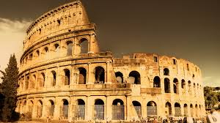
Ancient Civilizations GREEKS (Archaic to Classical Age)
Mrs. Thompson
6th Grade

Slide 2
History Before “Classical Age”
800 B.C. – 500 B.C. where known as the “Greek Dark Ages” or Archaic Age
750-600 B.C. – Greek colonies sprang up from the Mediterranean to Asia area and from North Africa to coast of the Black Sea
Rise of tyrants - those that became VERY wealthy from trade and resented the unchecked power of oligarchy and worked together to put new leaders in charge (tyrants) - some helped the city states while others where just as corrupt as the those in current government (oligarchy)

Slide 3
Time Period 800 B.C. to 13 B.C.
Greek Dark Ages (Archaic Age) 800 B.C. – 500 B.C.
Classical Age – 500 B.C. – 336 B.C.
Hellenistic Age – 323 B.C. – 13 B.C.

Slide 4
Language (Written & Verbal)
Arachaic Age
The Mycenaean civilization at least as early as the thirteenth century BCE. The earliest texts are written in a script called Linear B– a syllabary, not an alphabet. That is, each symbol represents a unique syllable, not an individual sound. Linear B is more than a syllabary, though. The script includes over 100 characters, and while most represent syllables, some are logograms or ideograms (representing entire words or concepts).
In the late ninth the history of the language, but the most influential of these would ultimately prove to be the one spoken in Athens, called Attic. Well within the Hellenic period, though, Attic and Ionic—the form of the language spoken mainly in the Greek city states directly across the Aegean Sea from Athens—exerted significant influence on each other as the preferred forms of the language for oratory and philosophical prose, eventually producing a dialect now called Attic-Ionic.

Slide 5
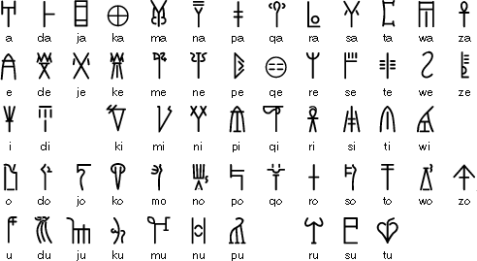
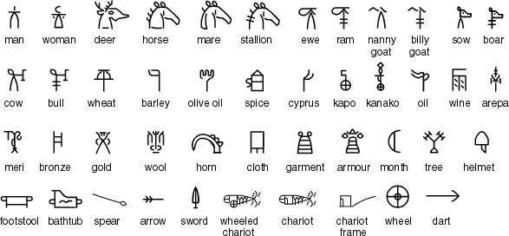
Earliest Written Language
Linear B was used between about 1500 and 1200 BC to write a form of Greek known as Mycenaean, named after Mycenae, where Agamemnon is said to have ruled. It . The Linear B inscriptions, most of which were accounting records listing materials and goods, are the earliest known examples of written Greek.
After the collapse of the Mycenaean civilization (around 1200 BCE) writing disappeared from Greece.

Slide 6
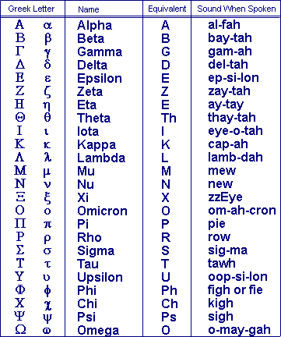
Greek Alphabet
This writing system that was developed in Greece about 1000 bc.
Greek symbols are used in mathematics and science today.

Slide 7
Religion
believed in gods and goddesses (polytheistic)
polite and creative
beautiful and perfect physical appearance
Twelve Olympians (main gods/goddesses)
Lived on Mount Olympus
As philosophy developed, it challenge the ideas of gods and goddess and citizens began to believe in Christianity
Festivals/rituals were used to encourage the gods to be generous

Slide 8
https://historymadeeveryday.files.wordpress.com/2013/09/greek-gods-chart2.jpg

Slide 9
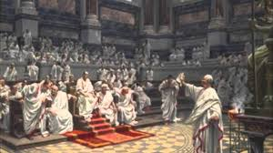
Government
kings ruled Athens; then an oligarchy (rule by the few), and then democracy (voting by the citizens) -- 1st to create a democratic government
City-states ((polis) – cities governed themselves) joined together to form leagues that came into conflict, weakening Greece and leading to its conquest by the Macedonian kings and later, the Roman Empire.
The Greek government did not have political parties. However, the Greeks realized that allowing public officials to be elected by popular vote would nearly always result in the wealthiest, most educated and most well-known citizens being elected. In order to make the government representative, Greek officials allowed election to some public offices -- those not requiring particular qualifications, such as military experience -- to be decided by a lottery system to which any citizen could submit their name.

Slide 10
Famous Leaders
Alexander the Great - Often called the greatest military commander in history, Alexander expanded the Greek empire to its greatest size, never losing a battle.
Cleisthenes - Called the Father of Athenian Democracy, Cleisthenes helped to reform the constitution so the democracy could work for all.
Demosthenes - A great statesman, Demosthenes was considered the greatest orator (speech giver) of Greek times.
Draco - Famous for his Draconian law that made many offenses punishable by death.
Pericles - A leader and statesman during the golden age of Greece. He helped democracy to flourish and led great building projects in Athens that still survive today.
Solon - Solon is usually credited with laying the foundations and ideas for democracy.

Slide 11
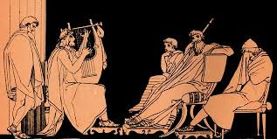
Art/Music
Greek art is considered superior to the "merely" imitative or decorative Roman art.
The goal of the classical Greek sculptors was to produce an ideal artistic form- lifelike nudes showed the ideal form of beauty
Drama – Tragedies had a hero with a tragic flaw
Comedy – satire (the use of humor, irony, exaggeration, or ridicule to expose and criticize people's stupidity or flaws - particularly in current politics and other important issues

Slide 12
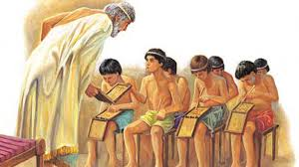
Education
Girls learned skills like weaving from their mothers.
Many girls also learned to read and write at home.
Boys were also taught at home when they were very young but they started school at the age of six.
Boys from a rich family were escorted to school by a slave.
The boys learned reading, writing and arithmetic as well as poetry and music.
The Greeks also believed that physical education was very important so boys did dancing and athletics.
Discipline was severe in Ancient Greek schools and children were often beaten.
In Sparta children were treated very harshly. At the age of 7 boys were removed from their families and sent to live in barracks. They were treated severely to turn them into brave soldiers. They were deliberately kept short of food so they would have to steal - teaching them stealth and cunning. They were whipped for any offense.
Spartan girls learned athletics and dancing - so they would become fit and healthy mothers of more soldiers.

Slide 13
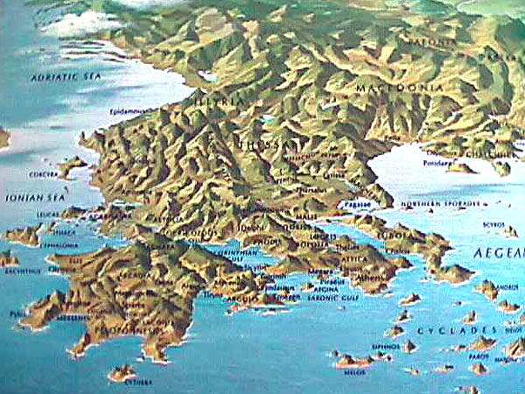
Topography of Land
Greece is a mountainous peninsula with a sharply fluctuating coastline and also includes several small islands.
Interaction between the Greek city-states was limited, causing each city-state to develop independently of one another.
The aristocracy of each city-state defended its independence and discouraged any efforts to form a monarchy.

Slide 14
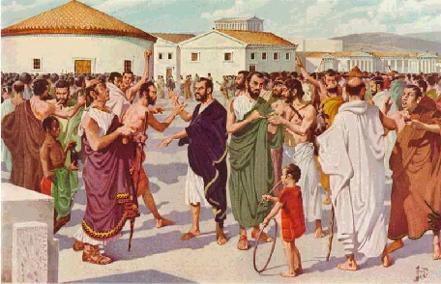
Life as a Citizen
Greek houses were usually small, although they could be large if the family had enough money, and some were even two stories high.
The thick walls of the houses were made out of mud and clay, and the floors were packed dirt.
Some of the richer families could afford to decorate the inside of the walls of their houses with paintings, and some of them were able to afford to put a mosaic of tiles on the floor.
A typical Greek would eat a lump of bread dipped in olive oil for breakfast, and the rest of the day would eat variations of grains and fish. Meat such as beef was reserved for festivals and feasts, and sugar was unknown. If the ancient Greeks ever ate anything sweet, it was because of honey.
In the winter time, fishing and farming was suspended, or stopped, so most Greeks spent a lot of their time outside meeting with friends and family or hanging out in public places, which is still true today.

Slide 15
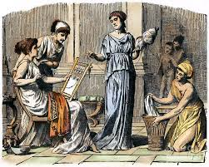
Role of Women
Women in Greece did not possess any rights as citizens. The highest regard they could attain was being the wife of a citizen.
Women were valued for not gossiping, for managing the household, and, most of all, for producing legitimate children
The aristocratic woman was secluded in the women's quarter and had to be accompanied in public places. She could own, but not sell property. The Athenian woman was subject to her father, and even after marriage, he could ask for her return.

Slide 16
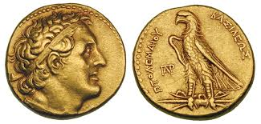
Economy
Based on agriculture
ideally lived on small self-sufficient wheat-producing farms, but bad agricultural practices made many households incapable of feeding themselves.
thought trade was degrading
worked in mines
had slaves but dependent on them

Slide 17
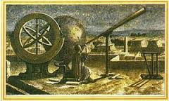
Science and Technology
Ptolemy - earth is the center of universe
(this idea lasted for 1,000 years)
Eratosthenes – determined that the earth was round and calculated its circumference (24, 675 miles)
Euclid – wrote the Elements - textbook on plan geometry

Slide 18
Inventions – Innovations – Key Achievements
1st Olympics – 776 BC
Waterwheel, odometer, map making (cartography), earliest medicine, basic geometry, democracy form of government, etc.
In the Hellenistic Age (323 BC-13 BC) , Greeks also invented :
a new money system
built more roads and canals
cleared the seas of pirates
(Hellenism: blend of the Greek and local cultures – means “to imitate the Greeks”)

Slide 19
Important Scientist-Philosophers-Historians
Greek Historians
Herodotus - A historian who chronicled the Persian Wars, Herodotus is often called the Father of History.
Thucydides - A great Greek historian who was known for the exact science of his research, he wrote about the war between Athens and Sparta.
Greek Scientists
Archimedes - He is considered one of the great mathematicians and scientists in history. He made many discoveries both in math and physics including many inventions.
Aristarchus - An astronomer and mathematician, Aristarchus was the first to put the sun at the center of the known universe rather than the Earth.
Euclid - The Father of Geometry, Euclid wrote a book called Elements, likely the the most famous mathematical textbook in history.
Hippocrates - A scientist of medicine, Hippocrates is called the Father of Western Medicine. Doctors still take the Hippocratic Oath today.
Pythagoras - A scientist and philosopher, he came up with the Pythagorean Theorem still used today in much of geometry.

Slide 20
DID YOU KNOW??
In later Greek history, which is called Hellenistic Greece, the economy expanded to areas in North Africa and Persia. Because of this, Greek products were in higher demand than before. Greeks began planting new crops and using new agricultural techniques. They also grew new and different wines, and invented better irrigation techniques in order to water their crops.

